Slide 1


ACT® Aspire®
Inviting Users in
PearsonAccess^{next}
Notes:
Welcome to the ACT® Aspire® Inviting Users in PearsonAccess^{next} training. This training addresses the steps required for adding or enabling user accounts in PearsonAccess^{next}.

Slide 2


Agenda
User Import File Upload
Create / Enable User Accounts Manually
Notes:
During the training, we’ll review how to perform the following tasks in PearsonAccess^{next}:
User Import File Upload
Create or Enable User Accounts Manually

Slide 3
User Import File Upload
Notes:
The Administration Test Coordinator or Test Coordinator must ensure that all appropriate testing staff have access to PearsonAccess^{next} with the correct user role and will be responsible for adding or enabling user accounts.
New users who previously have not had an account in PearsonAccess^{next} will receive an account set up email with instructions to create their accounts.
Existing users will not receive an email; they may access their accounts using their already-established credentials after their accounts are enabled. The Administration Test Coordinator or Test Coordinator should notify the user that they may access PearsonAccess^{next}.
There are two ways to add users to PearsonAccess^{next}. You can add users manually or by file import.
First, we will cover the User Import process.

Slide 4
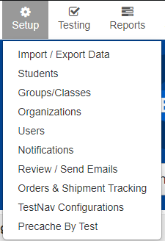
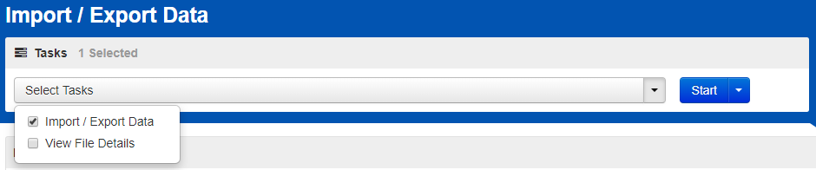

User Import File Upload
Setup > Import / Export Data
https://az-support.mypearsonsupport.com/aspire/
Notes:
Users with the Administration Test Coordinator and Test Coordinator roles are able to import User Import Files in PearsonAccess^{next}.
Use the resources under the “Managing Users” menu of the Arizona ACT Aspire Support page to guide you through the process for importing users.
To import a User Import File, you must first export the User Import File Layout. Go to the “Setup” menu and select “Import/Export Data.” Select the “Import/Export Data” task. Then select “Start”.

Slide 5
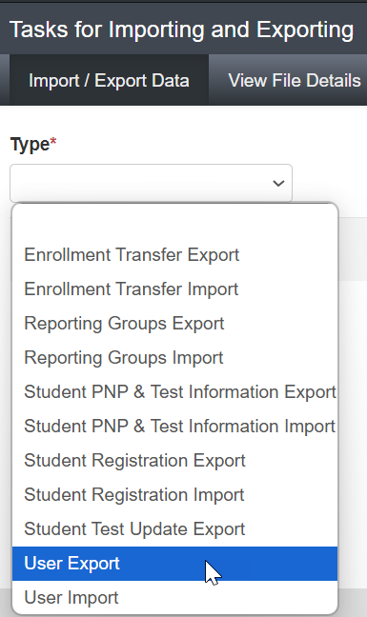
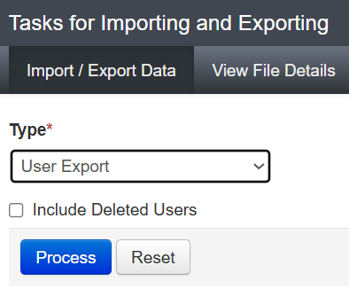
User Import File Upload
User Export
Notes:
On the Tasks for Importing and Exporting screen, select the “User Export” type, then click “Process.”

Slide 6
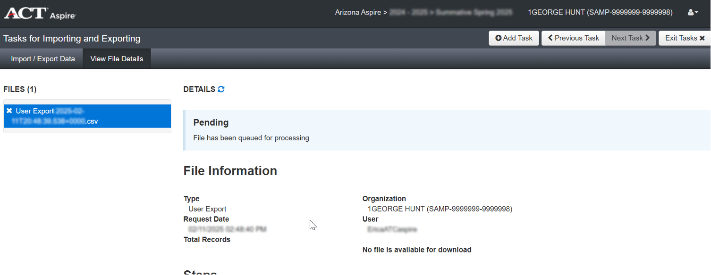
User Import File Upload
User Export
Notes:
The file will show in pending status until the download is complete. You can click on the refresh button next to “Details” to see the status change, but you’ll also get an email when the file is Complete.

Slide 7
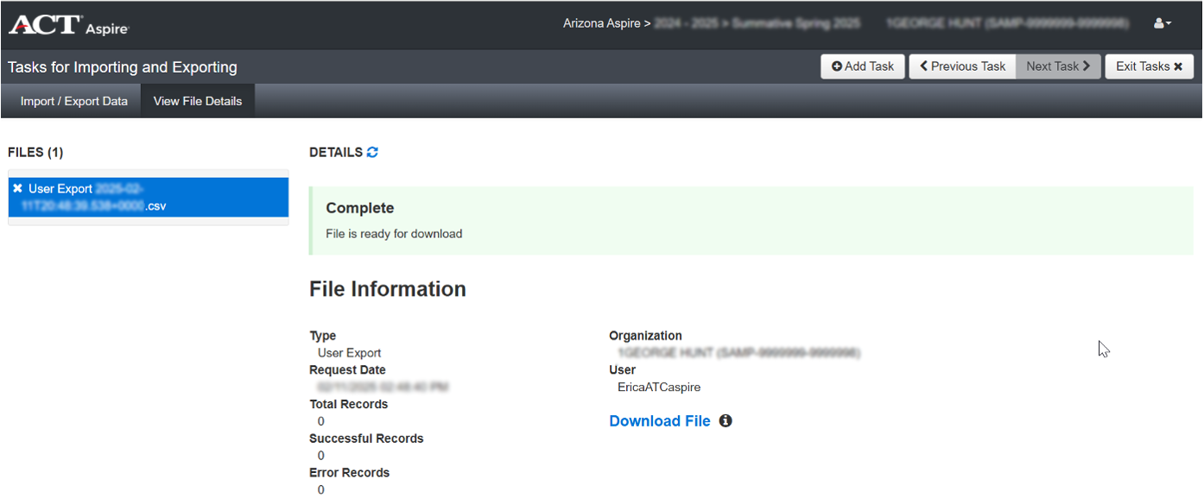
User Import File Upload
User Export
Notes:
When the file is ready to download, the status will change to Complete, and you will be able to download the file.
All files exported out of PearsonAccess^{next} are CSV files, so it will be important that you download and open the files in a way that preserves leading zeros and number formatting.

Slide 8
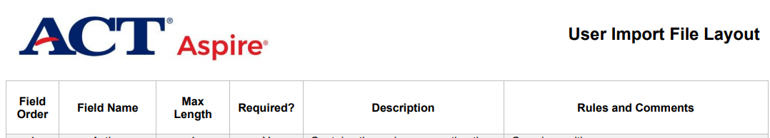
User Import File Upload
User Import File Layout
https://az-support.mypearsonsupport.com/aspire/
Notes:
Download the User Import File Layout instructions from the Arizona ACT Aspire Support Page in the “Managing Users” section.
Use the User Import File Layout instructions to add all required information to the file. The layout instructions let you know which fields are required and what characters are accepted in each column of the User Import File Layout.
When you have completed the file, save it as a CSV file format. You will get a prompt that asks whether you want to keep that file format or change it. Say “Yes” you want to keep the file using that format.
Save the file with a recognizable name and in a location where you’ll be able to find it easily to import to the system.

Slide 9
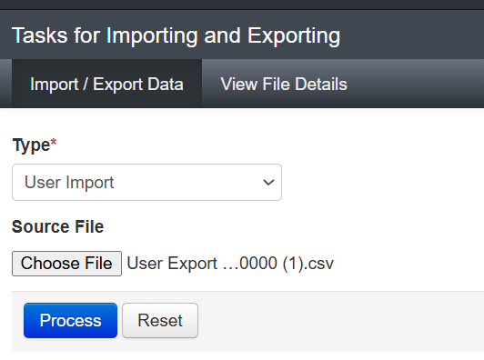
User Import File Upload
Setup > Import / Export Data
Notes:
Once you have completed and saved the file, navigate back to PearsonAccess^{next}, and the Import/Export task screen. Select “User Import” from the Type dropdown menu. Use the “Choose File” button to access the saved User Import File, then click the “Process” button.

Slide 10
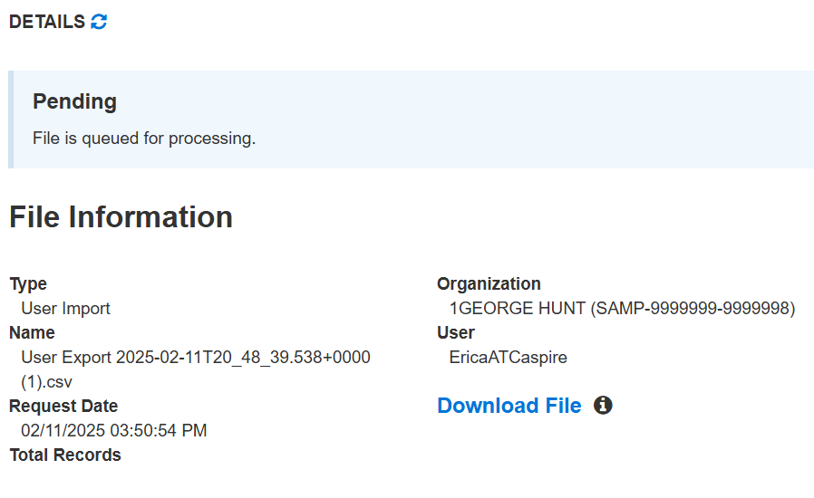
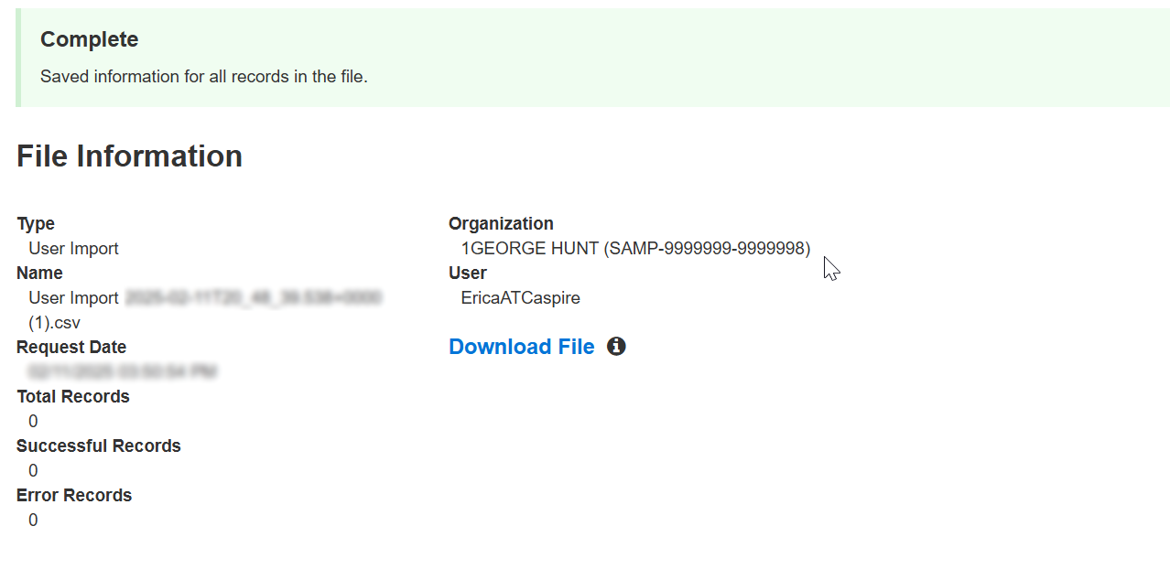
User Import File Upload
User Import
Notes:
If the file is done, it will change to “Complete”. If it isn’t done, wait a little longer and click refresh.
Again, your file will process, and you will see a notification when the file upload is “Complete”.
On the “Complete” page, you’ll also be notified if there are any errors in your file. The errors will show on the page, or you’ll be able to download the records in error, correct them, and upload them again.

Slide 11
Create / Enable user accounts manually
Notes:
Next, we will look at creating and enabling user accounts manually in PearsonAccess^{next}.

Slide 12
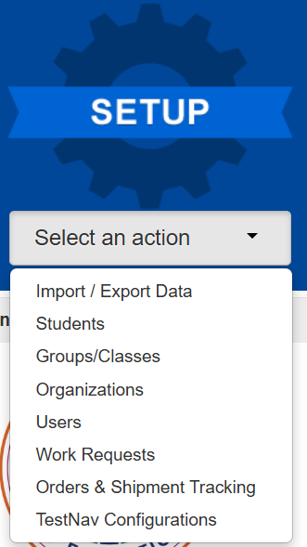
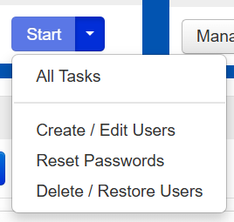
Create and enable user accounts manually
Create Users
Notes:
To create a user account, select “Users” from the “Setup” menu on the PearsonAccess^{next} home screen.
Next, from the “Users” page, select “All Tasks” from the “Start” menu.

Slide 13
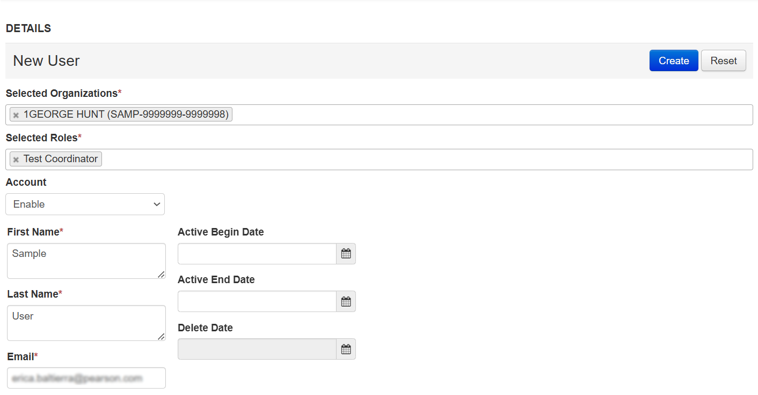
Create and enable user accounts manually
Create Users
Notes:
The “Tasks for Users” page will open on the “Create/Edit Users” tab.
Fill in the New User details. All required fields are indicated with an asterisk.
When all information is entered, click the “Create” button.
A green “Success” banner will appear to confirm the user account was created successfully.

Slide 14
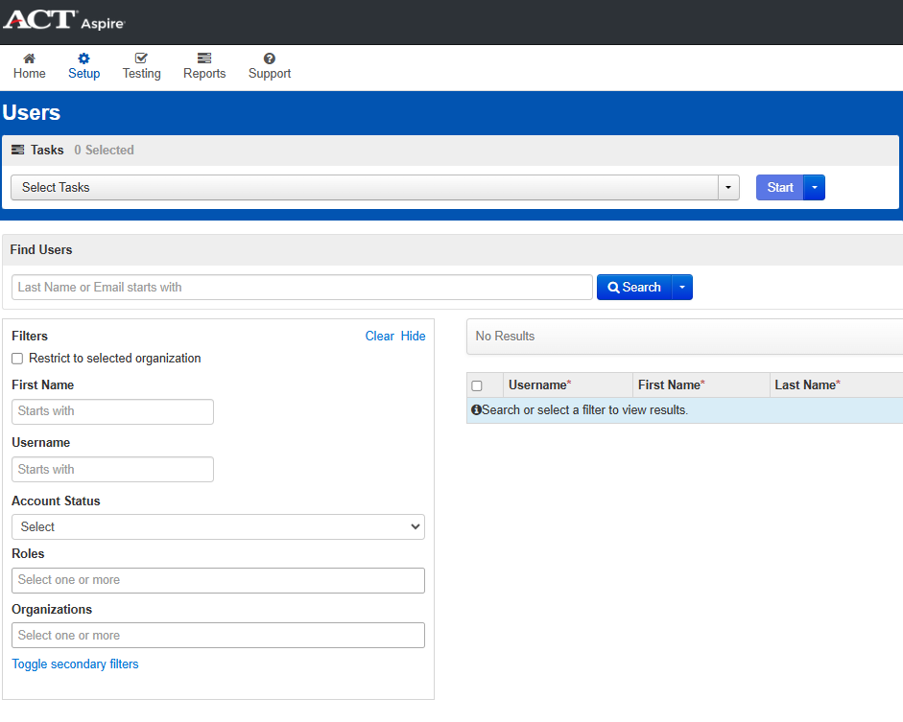
Create and enable user accounts manually
Enable Existing Users
Notes:
To enable an existing user account, on the “Users” page, use the filters on the left side of the page to search for the user. You can search for a user by typing the user’s last name or email address in the “Find Users” field and clicking the “Search” button.

Slide 15
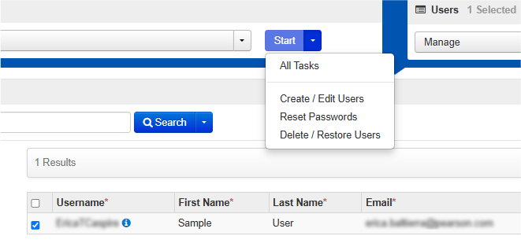
Create and enable user accounts manually
Enable Existing Users
Notes:
Once you have located the user, place a check in the checkbox by their Username, then go to “Start > All Tasks”.

Slide 16
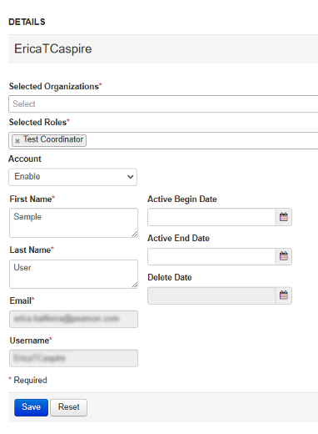
Create and enable user accounts manually
Enable Existing Users
Notes:
On the User Details page, you will see the “Selected Organizations” field is blank. The “Selected Organizations” field is a multi-select field that will allow you to select the appropriate school or schools the user should have access to. Once you click in the field, select the desired school or schools from the dropdown list.
Review all other information for accuracy. Please note, “Active Begin Date” and “Active End Date” fields are not required. These fields will control the user’s access to the Aspire test administration, so be sure the active dates cover the time the user will require access to PearsonAccess^{next}. Click the “Save” button when finished. A green “Success” banner will appear as confirmation that the changes to the User account have been applied.

Slide 17
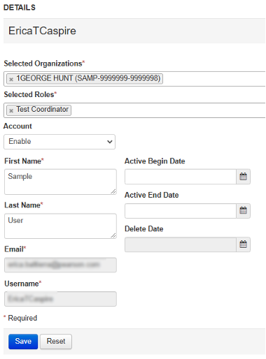
Create and enable user accounts manually
Enable Existing Users
Notes:
Upon user account creation, the user’s account is set to Enabled status by default. At any point after creation, the user’s account may be set to Disabled status to remove the user’s access. A user’s account in Disabled status may also be set to Enabled status to restore access.

Slide 18
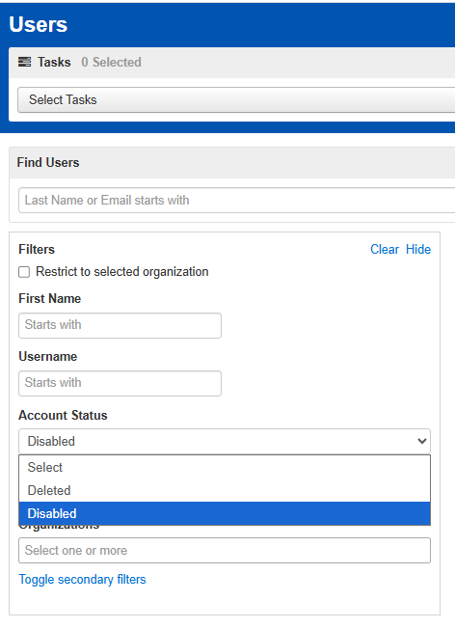
Create and enable user accounts manually
Enable Existing Users
Notes:
To search for a disabled or deleted user, on the Users page, use the “Account Status” filter to select either Deleted or Disabled.

Slide 19
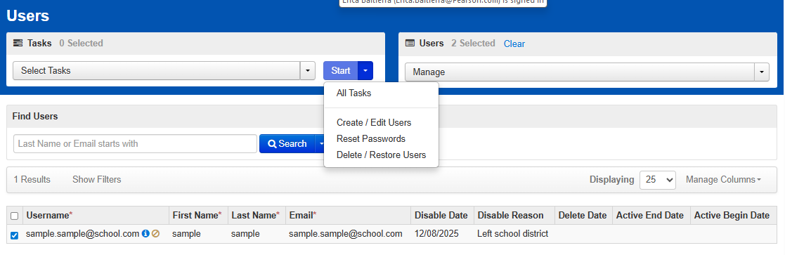
Create and enable user accounts manually
Enable Existing Users
Notes:
Place a check in the check box for the desired user account, then click “Start > All Tasks”.

Slide 20
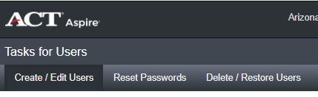
Create and enable user accounts manually
Enable Existing Users
Notes:
Select the “Create/Edit Users” tab on the Tasks for Users screen.

Slide 21
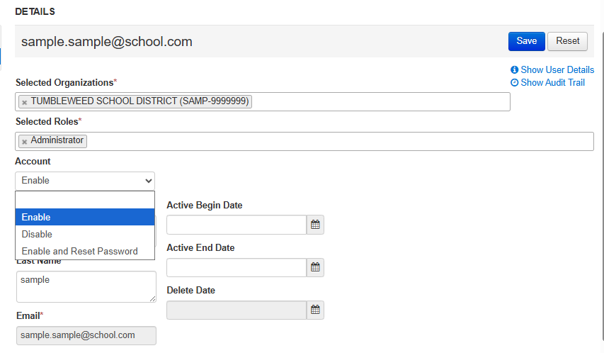
Create and enable user accounts manually
Enable Existing Users
Notes:
On the Create/Edit Users page, use the Account dropdown menu to select Enable, Disable, or Enable and Reset Password.
Once the appropriate account status is set, check the Active Begin and Active End Dates. Active Begin and Active End Dates are not required fields but may be used to control the time period the user will have access to PearsonAccess^{next}.
Verify all account information then click “Save.”

Slide 22
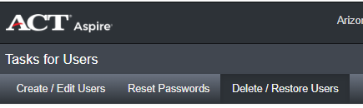
Create and enable user accounts manually
Enable Existing Users
Notes:
To reinstate a deleted account, go to the “Delete/Restore Users” tab.

Slide 23
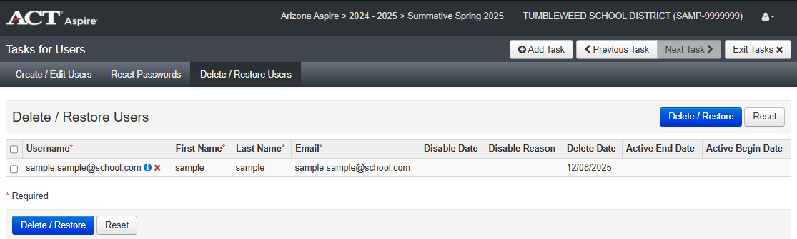
Create and enable user accounts manually
Enable Existing Users
Notes:
On the Delete/Restore Users page, a deleted User Account is indicated with a red “X” in the Username column.

Slide 24
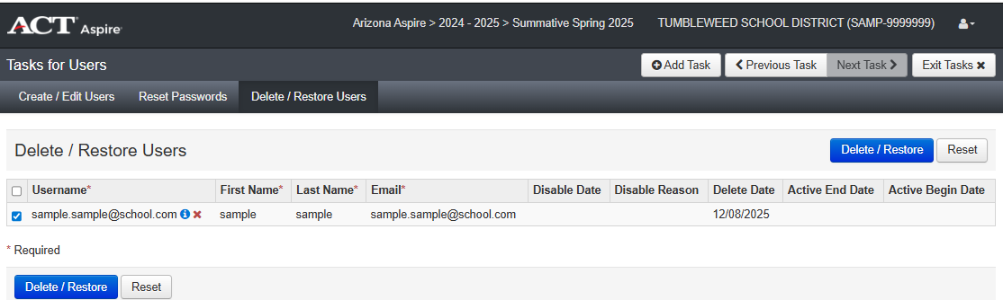
Create and enable user accounts manually
Enable Existing Users
Notes:
To reinstate the account, place a check in the checkbox, then click the “Delete/Restore” button.

Slide 25
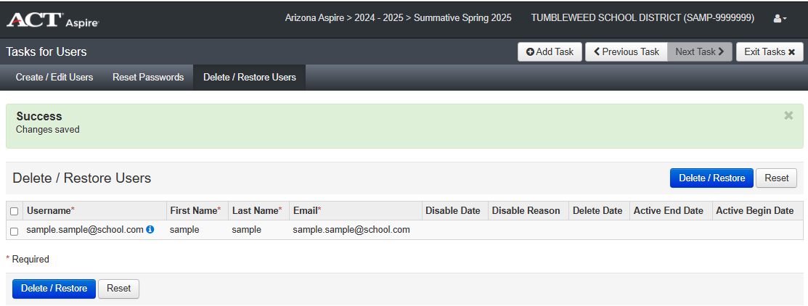
Create and enable user accounts manually
Enable Existing Users
Notes:
A green “Success” banner will appear to indicate the change was saved. Confirm that the “Active End Date” and “Active Begin Date” are either blank or within the date ranges for expected use. If the “Active End Date” or “Active Begin Date” requires an update, click on the “Create/Edit Users” tab to continue editing the user account.

Slide 26
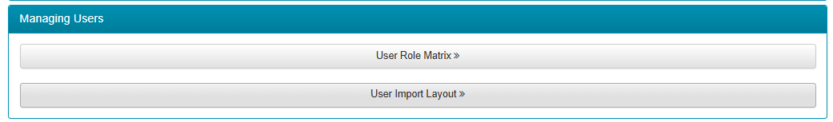
Resources
Web pages and Resources
Arizona ACT Aspire Support Page
https://az-support.mypearsonsupport.com/aspire/
Notes:
The Arizona ACT Aspire Support Page contains useful information for managing users in PearsonAccess^{next}.
We suggest bookmarking the Arizona ACT Aspire Support Page for future reference.

Slide 27

Questions? We’re here to help!
Pearson Customer Support
Phone: 1.888.705.9421 Option 4 (ACT Aspire), 7:00 a.m. – 7:00 p.m., central time, Monday through Friday
Notes:
This concludes the ACT Aspire Inviting Users in PearsonAccess^{next} training. If you have any questions, please contact us at the number provided on this slide.

